Slide 1
Interim Project Presentation 1
Eric, Owen, Richard

Slide 2
Proposal Recap
Problem statement:
  After events end, photos and memories get buried in personal galleries or scattered across social media
Why it matters:
  Builds a collective memory map connecting people through shared experiences, allowing people to preserve meaningful moments tied to real-world places
Planned Features (MVP)
  Event Map : Map view with pins for past & upcoming events using Google Maps API
  Event Creation: User create / join event by location using TicketMaster API
  Memory Wall: Scrollable grid showing uploaded memories from users
  Authentication
  Database + Storage : Store events, users , memories, images
What’s changed?
  Adapting the application to work with our technology (i.e. Given we have this Ticketmaster event data, incorporating it alongside user-defined events seamlessly)

Slide 3
Current Architecture Overview
MVVM + Repository pattern
UI layer
  Compose screens + reusable components
View Models layer
  UI state
Repository layer
  For external data sources (Firebase, API calls, local DB)
Jetpack Compose Navigation
Firebase
  Authentication, database, file storage
DataStore
  Saving user data/preferences/information
Ticketmaster API
  Retrieving filtered events
Google Maps API
  Map feature

Slide 4
Team Workflow
GitHub
  Dev branch
  Feature branches pushed to dev
  Merge to main at end of project
Eric
  Ticketmaster API + navigation
Richard
  Google Maps API
Owen
  Events detail screen + ViewModel

Slide 5
Challenges Faced
Structuring the project
Calling APIs
  Needed to add network access permission in Manifest.xml
Efficient asynchronous team workflow
  GitHub & communication
Kotlin version
  Google maps
  Libs.versions.toml
  2.2.x

Slide 6
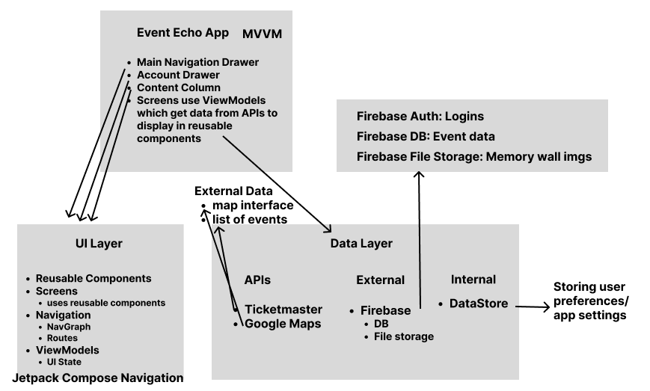

Slide 7
